Slide 1
Effectiveness of community mobilization and group-based interventions for preventing intimate partner violence in low- and middle-income countries: A systematic review and meta-analysis
Jessica Leight, IFPRI
Joint with Claire Cullen (Oxford), Meghna Ranganathan (LHSTM), and Alexa Yakubovich (Dalhousie Medical School)

Slide 2
Motivation
Intimate partner violence (IPV) is a global human rights and public health challenge.
Recent estimates suggest that 27% of ever-partnered women and girls aged 15—49 have ever experienced physical or sexual violence by an intimate partner, with the highest prevalence estimates in low and middle-income countries (LMICs).
IPV has major implications for the health and wellbeing of women, their families, and communities.

Slide 3
Motivation
Conceptual models highlight that the unequal position of women in relationships, inequitable social norms, and the normalization of violence are all risk factors for IPV.
Building on these insights, an increasingly large number of gender-transformative interventions have been developed and evaluated.
Defined by the WHO: a gender-transformative approach “seeks to challenge gender inequality by transforming harmful gender norms, roles and relations through programmatic inclusion of strategies to foster progressive changes in power relationships between women and men.”

Slide 4
This paper
Our aim is to conduct a systematic review and meta-analysis drawing on randomized controlled trials of community-level or group-based interventions targeting the prevention and reduction of IPV in LMICs, unified by a shared theory of change.
What is the TOC? Shifting community attitudes, social norms, and individual behaviours through participatory processes is essential for preventing IPV.
We expand the scope of meta-analytic evidence for a rapidly growing, cutting-edge body of literature.

Slide 5
Inclusion criteria for the systematic review
The meta-analysis includes only randomized controlled trials conducted in LMICs.
Trials are included evaluating interventions:
Focused on preventing and reducing IPV
Community-level or group-based (i.e., not one-on-one therapeutic interventions)
Not primarily economic
Do not target adolescents; women who are sex workers; or women who have already been identified as experiencing IPV
We identify 30 trials, of which 29 are included in the meta-analysis; 20 of the 30 were published in 2018 or later.
26 of the 30 are from sub-Saharan Africa.

Slide 6
PRISMA flow diagram
9498 records identified through database searching
2136 duplicates excluded
7363 records included in screening
7,309 records excluded based on title and abstract
3 additional relevant titles identified through hand searching
57 full-text articles screened for eligibility
27 records excluded
11: intervention does not meet specified criteria
5: IPV outcomes not collected
7: experimental design does not meet specified criteria
5: sample definition
30 included
in the review

Slide 7
Trial sites
Afghanistan, Bangladesh, Nepal: 1 trial each
Côte d’Ivoire:
2 trials
Tanzania:
6 trials
Colombia:
1 trial
South Africa:
8 trials
Rwanda: 3 trials
Uganda: 3 trials

Slide 8
Data
The outcomes of interest include past-year experience of violence (emotional, physical, sexual IPV; economic IPV; or any IPV) as reported by women; and perpetration of IPV (physical or sexual) reported by men.
We extract and code a range of information about the study design, statistical methods, and intervention design (including target population, mode of delivery, thematic material included, and duration).
We also assess risk-of-bias using the Cochrane risk of bias tool.

Slide 9
Intervention coding
Intervention type | Target population | Additional themes | Duration
Community mobilization (5 trials) | Cohabiting couples (7 trials) | Sexual and reproductive health (15 trials) | Number of contact hours (median 36)
Women’s group-level intervention (6 trials) | Youth (5 trials) | Substance use (7 trials) | Total duration of programming (median 0.77 years)
Men’s group-level intervention (5 trials) |  | Economic empowerment (4 trials)
Couples’ group-level intervention (4 trials) |  | Parenting (3 trials)
Joint intervention (12 trials)

Slide 10
Analysis
We estimate a multi-level (three-level) random-effects meta-analysis model.
The multilevel model includes all available estimated effects for each trial (both primary and secondary outcomes, as reported across multiple arms if applicable), and accounts for the dependence across estimated effects within the same trial.
Separate models are estimated for unadjusted and adjusted coefficients.
In addition, we estimate a meta-regression, analyzing the extent to which intervention characteristics moderate the effect size.

Slide 11
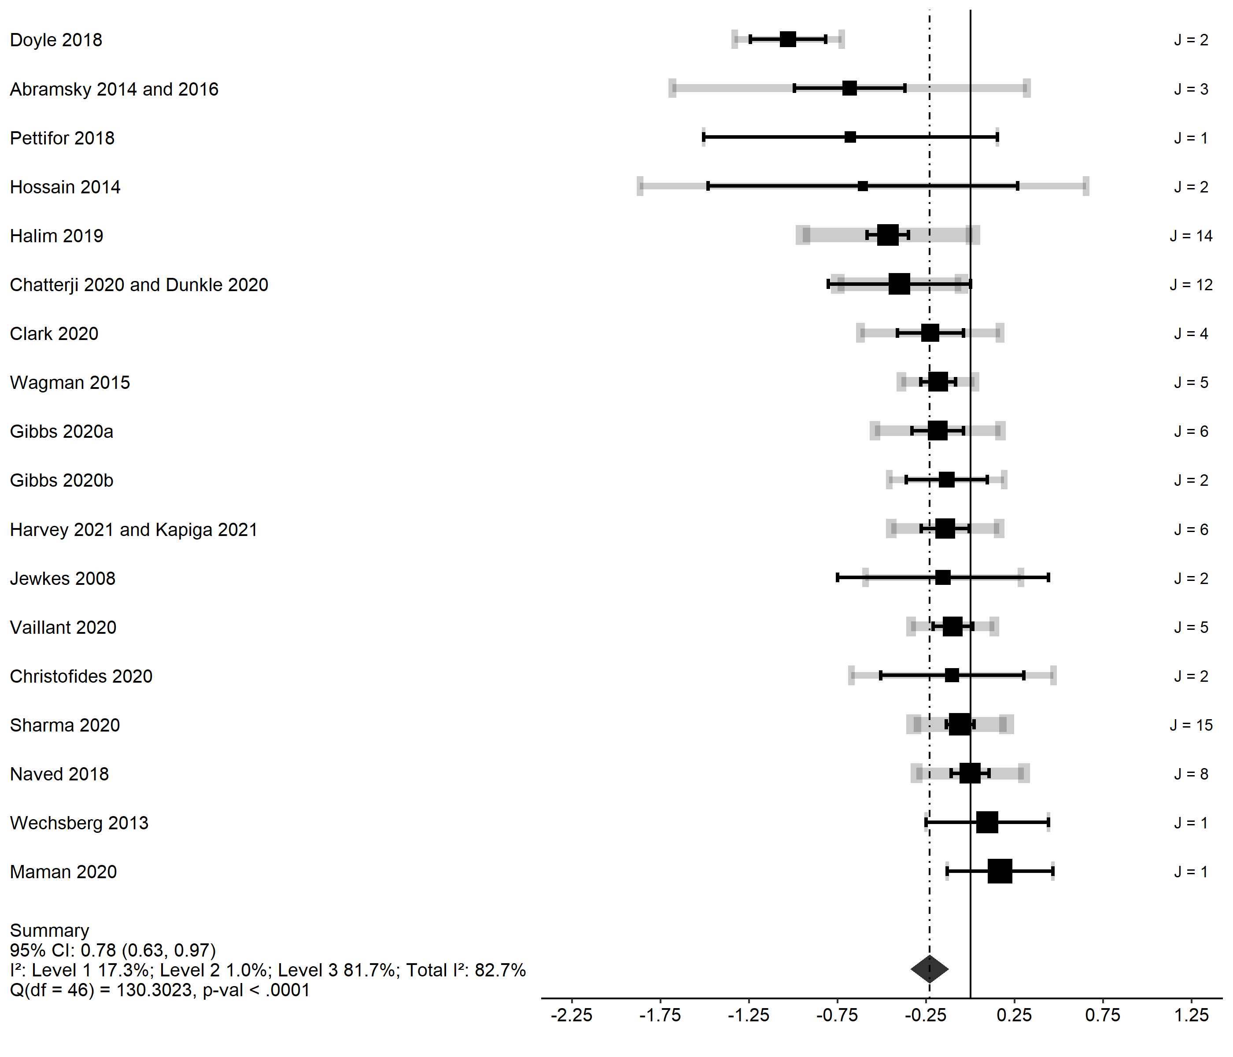
Forest plot

Slide 12
Key findings
Our meta-analysis suggests that community-level or group-based interventions reduce the odds of reported IPV in the past year (pooled aOR 0.78; 95% CI [0.63, 0.96]).
There is wide heterogeneity in the effect sizes between trials (I²=82%).
These findings are robust in a range of sensitivity analyses.
Removing trials with higher risk of bias
Removing estimates drawing on perpetration data
Conducting the meta-analysis with a single estimate per trial
Conducting separate meta-analyses for different reported types of violence

Slide 13
Meta-regression
(intervention type; target population)
Intervention type (Referent: Joint intervention) | Risk ratio (95% CI)
Women | 0.984 (0.537, 1.802)
Men | 0.826 (0.454, 1.502)
Couples | 0.839 (0.456, 1.542)
Community | 0.623 (0.327, 1.188)
Target population (Referent: No restrictions)
Youth | 0.616 (0.347, 1.094)
Cohabiting | 0.832 (0.467, 1.483)
Intercept | 1.088 (0.656, 1.084)
Test of Moderators (coefficients 2:7): | 0.984 (0.537, 1.802)
F(df1 = 6, df2 = 40) = 2.131, p-val = 0.071 | 0.826 (0.454, 1.502)

Slide 14
Meta-regression
(intervention components; duration)
Intervention components (Referent: no additional components)
HIV/SRH | 1.134 (0.815, 1.580)
Substance use | 0.536 (0.274, 1.050)
Economic empowerment | 1.502 (0.946, 2.387)
Parenting | 0.363 (0.229, 0.574)
Intervention duration (Referent: low intensity, short duration)
High intensity | 1.108 (0.801, 1.533)
Long duration | 0.700 (0.483, 1.017)
Intercept | 0.816 (0.619, 1.076)
Test of Moderators (coefficients 2:7):
F(df1 = 6, df2 = 40) = 4.159, p-val = 0.0024

Slide 15
Key findings
There is no evidence that intervention type was associated with intervention effectiveness.
Interventions targeting youth generated larger reductions in IPV (OR=0.62), though the association was variable (95% CI: [0.35, 1.09]).
There was also evidence that some intervention components were associated with effectiveness.
Interventions including a component targeting parenting practices showed larger reductions in IPV (OR=0.36, 95% CI: [0.23, 0.57]).
Interventions including a component targeting substance use showed a similar pattern that is noisily estimated. (OR=0.54, 95% CI: [0.27, 1.05]).

Slide 16
Key findings, cont.
Interventions of long duration (above the median of .77 years) were also weakly associated with larger reductions in IPV (OR=0.70, 95% CI: [0.48, 1.02]).

Slide 17
Summing up
To our knowledge, this is the first systematic, meta-analytic review that provides causal evidence on the effectiveness of gender-transformative IPV prevention programs in LMICs.
The 30 studies included in the review showed that these interventions led to a significant reduction in past-year IPV against women; this estimate draws on evidence from a broad range of diverse contexts.
There is also promising meta-analytic evidence suggesting that particular design features may render interventions even more effective in reducing violence.

Slide 18
Summing up, cont.
While several previous systematic reviews analysed economic interventions, there has been a notable evidence gap around the effectiveness of non-economic interventions.
Our analysis extends the existing literature by aggregating evidence from a clearly defined set of RCTs and providing an up-to-date overview of a rapidly growing evidence base.
Prior reviews suggested that there was potential for these strategies to be effective in reducing IPV in LMICs.
Our meta-analysis confirms this finding.

