Slide 1
Harnessing gender-transformative interventions for preventing intimate partner violence in low- and middle-income countries
Jessica Leight, IFPRI

Slide 2
Motivation
Intimate partner violence (IPV) is a global human rights and public health challenge.
Recent estimates suggest that 27% of ever-partnered women and girls aged 15—49 have ever experienced physical or sexual violence by an intimate partner, with the highest prevalence estimates in low and middle-income countries (LMICs).
IPV has major implications for the health and wellbeing of women, their families, and communities.

Slide 3
Motivation
Conceptual models highlight that the unequal position of women in relationships, inequitable social norms, and the normalization of violence are all risk factors for IPV.
Building on these insights, an increasingly large number of gender-transformative interventions have been developed and evaluated.
Defined by the WHO: a gender-transformative approach “seeks to challenge gender inequality by transforming harmful gender norms, roles and relations through programmatic inclusion of strategies to foster progressive changes in power relationships between women and men.”

Slide 4
Overview
Goal today: describe one large-scale trial I co-led evaluating the effectiveness of a group-based IPV prevention intervention delivered to men, women or couples in rural Ethiopia.
I will also report on some papers analyzing innovations linked to the measurement of IPV that draw on data conducted in the trial.
Finally, I’ll describe a meta-analysis I also led seeking to synthesize evidence around this literature.

Slide 5
Unite for a Better Life
We conducted a cluster randomized trial to evaluate the effectiveness of Unite for a Better Life (UBL), a participatory, gender-transformative IPV and HIV prevention intervention delivered to either groups of women, men or couples.
Joint with Vandana Sharma (HSPH) and Negussie Deyessa (AAU)
UBL is delivered in the context of the Ethiopian coffee ceremony, a traditional forum for community-based discussions.
The trial included a sample of 64 villages in southern Ethiopia randomly assigned to one of four trial arms: women’s UBL, men’s UBL, couple’s UBL or a control group.

Slide 6
Study Design
The baseline sample included 6,770 respondents (cohabiting couples only) randomly selected within the study villages.
At baseline, we randomly assigned households to have either the male or female spouse surveyed; we then surveyed both spouses at endline.
Follow-up data was available from 88% of baseline respondents, and 87% of their spouses.
Primary outcomes included women’s past-year experience of IPV and men’s past-year perpetration of IPV, along with comprehensive knowledge on HIV and condom use at last intercourse.

Slide 7
Intervention
Curricula designed for women, men and couples were developed jointly with EngenderHealth, and all three curricula were pilot-tested in non-study villages and refined prior to the trial.
The final curricula included 14 participatory and skills-building sessions (total 38 hours) led by one trained, same-sex facilitator for men’s and women’s UBL groups, and one female and one male facilitator for couples’ groups to assist participants to identify and transform power imbalances within their relationships and to build skills for healthy, non-violent, equitable relationships.
This included a focus on healthy sexuality, sexual communication, safe sex, and reduction of HIV risk behaviors.

Slide 8
Coffee ceremony and sample population
As traditionally women prepare coffee during the coffee ceremony, implementing the curriculum within this context offered an opportunity to model and promote more equitable behaviors – men are also expected to prepare coffee! – and also increased cultural relevance.
Overall, the program was well-received and attendance was high.
81% of sampled respondents completed at least 70% of sessions.
In the survey sample, women were on average 32 years of age, while men were 37 years. Roughly 75% of women had no formal schooling, and 16% of women reported being in polygamous relationships. Approximately 61% of households were Muslim.

Slide 9
Analysis
Given the randomized trial, the primary analysis is an intent-to-treat; we estimate logit models.

Slide 10
Primary outcomes: IPV
 | Summary Statistics |  |  |  | Intervention Effect
 | Control Group | Couples' UBL | Women's UBL | Men's UBL | Couples' UBL |  | Women’s UBL |  | Men's UBL
 | N (%) | N (%) | N (%) | N (%) | OR | AOR* | OR | AOR* | OR | AOR*
PRIMARY IPV OUTCOMES
Experience of Intimate Partner Violence (IPV) – Women’s Reports
Past-year physical IPV | 292/1452 (20.1) | 255/1249 (20.4) | 267/1211 (22.1) | 268/1233 (21.7) | 1.01 (0.79-1.28) p=0.940 | 1.00 (0.77-1.30) p=0.973 | 1.11 (0.88-1.42) p=0.379 | 1.11 (0.87-1.42) p=0.414 | 1.10 (0.89-1.35) p=0.386 | 1.02 (0.81-1.28) p=0.865
Past-year sexual IPV | 542/1451 (37.4) | 424/1248 (34.0) | 494/1212 (40.8) | 430/1228 (35.0) | 0.86 (0.65-1.15) p=0.310 | 0.86 (0.62-1.20) p=0.378 | 1.14 (0.91-1.44) p=0.255 | 1.15 (0.89-1.50) p=0.291 | 0.88 (0.72-1.08) p=0.231 | 0.80 (0.63-1.01) p=0.062
SECONDARY IPV OUTCOMES
Perpetration of IPV – Men’s Reports
Past-year physical IPV | 313/1459 (21.5) | 272/1268 (21.5) | 309/1230 (25.1) | 242/1244 (19.5) | 0.98 (0.70-1.36) p=0.884 | 0.97 (0.70-1.35) p=0.866 | 1.23 (0.90-1.68) p=0.192 | 1.21 (0.88-1.67) p=0.232 | 0.87 (0.67-1.12) p=0.281 | 0.85 (0.65-1.09) p=0.200
Past-year sexual IPV | 427/1459 (29.3) | 347/1268 (27.4) | 382/1229 (31.1) | 303/1244 (24.4) | 0.87 (0.62-1.24) p=0.447 | 0.87 (0.61-1.25) p=0.462 | 1.08 (0.86-1.36) p=0.506 | 1.07 (0.84-1.37) p=0.570 | 0.76 (0.59-0.97) p=0.026 | 0.73 (0.56-0.94) p=0.014

Slide 11
Primary outcomes: HIV, social norms (women)
 | Summary Statistics |  |  |  | Intervention Effect
 | Control Group | Couples' UBL | Women's UBL | Men's UBL | Couples' UBL |  | Women’s UBL |  | Men's UBL
 | N (%) | N (%) | N (%) | N (%) | OR | AOR* | OR | AOR* | OR | AOR*
SECONDARY HIV OUTCOMES
Comprehensive knowledge on HIV | 95/770 (12.3) | 116/643 (18.0) | 92/607 (15.2) | 71/637 (11.2) | 1.58 (1.03-2.41) p=0.036 | 1.56 (1.02-2.39) p=0.040 | 1.27 (0.82-1.96) p=0.285 | 1.26 (0.82-1.93) p=0.300 | 0.88 (0.54-1.42) p=0.604 | 0.86 (0.54-1.37) p=0.525
Condom use at last intercourse | 5/769 (0.65) | 16/639 (2.5) | 11/606 (1.8) | 5/633 (0.8) | 3.9 (1.62-9.42) p=0.002 | 4.52 (1.85-11.01) p=0.001 | 2.87 (1.31-6.30) p=0.009 | 3.12 (1.36-7.13) p=0.007 | 1.24 (0.39-3.90) p=0.719 | 1.35 (0.42-4.38) p=0.615
KNOWLEDGE, ATTITUDES, HOUSEHOLD DECISION-MAKING AND TASK-SHARING OUTCOMES
IPV Knowledge, Attitudes, Norms†
Knowledge of IPV laws | 413/770 (53.6) | 364/643 (56.6) | 353/607 (58.2) | 381/637 (59.9) | 1.13 (0.89-1.43) p=0.312 | 1.12 (0.88-1.42) p=0.352 | 1.21 (0.99-1.47) p=0.058 | 1.20 (0.99-1.45) p=0.056 | 1.28 (0.99-1.66) p=0.053 | 1.31 (1.02-1.68) p=0.034
Support for gender equitable norms | 305/770 (39.6) | 281/643 (43.7) | 280/607 (46.1) | 236/637 (37.1) | 1.18 (0.95-1.48) p=0.138 | 1.21 (0.97-1.52) p=0.092 | 1.29 (1.01-1.67) p=0.045 | 1.32 (1.04-1.68) p=0.020 | 0.89 (0.65-1.21) p=0.455 | 0.89 (0.65-1.21) p=0.455
Do not believe IPV is justified | 299/770 (38.8) | 277/643 (43.1) | 266/607 (43.8) | 237/637 (37.2) | 1.20 (0.94-1.54) p=0.144 | 1.21 (0.93-1.58) p=0.150 | 1.22 (0.94-1.57) p=0.140 | 1.22 (0.94-1.58) p=0.137 | 0.93 (0.72-1.19) p=0.554 | 0.93 (0.73-1.18) p=0.537
Household Decision-Making and Division of Childcare and Household Tasks
Male involvement (household & childcare tasks) | 84/1460 (5.8) | 101/1253 (8.1) | 76/1217 (6.2) | 85/1236 (6.9) | 1.45 (1.06-2.00) p=0.021 | 1.47 (1.08-2.01) p=0.016 | 1.08 (0.72-1.62) p=0.704 | 1.06 (0.70-1.61) p=0.777 | 1.21 (0.88-1.68) p=0.244 | 1.18 (0.84-1.66) p=0.350
Male dominance in decision-making (spending time with family/friends) | 608/1453 (41.8) | 512/1245 (41.1) | 496/1206 (41.1) | 540/1227 (44.0) | 0.96 (0.73-1.26) p=0.775 | 0.95 (0.72-1.25) p=0.726 | 0.97 (0.75-1.25) p=0.801 | 0.96 (0.74-1.23) p=0.731 | 1.10 (0.85-1.43) p=0.460 | 1.13 (0.87-1.46) p=0.368

Slide 12
Learning more about measurement
Given the scope of data collection for the trial, we also sought to incorporate some measurement innovations.
We included retrospective questions for respondents to report their exposure to intimate partner violence in their natal home (among parents).
We also surveyed both men and women at endline about their perpetration of / experience of IPV, and thus have symmetric reports within households.
Analyzing this data, we identified two other empirical patterns that may inform future research (particularly longitudinal analysis).
The cross-generational correlation between experience of IPV in the natal home and reports of IPV in the marital home are essentially null: https://www.sciencedirect.com/science/article/pii/S0305750X20304873

Slide 13
Discordance
In addition, discordance between men and women in reporting IPV in the marital home is significant.
Using both male and female reports of IPV to construct a household-level measure of IPV leads to a huge increase in the reported prevalence: prevalence of physical IPV increases from 21% to 37%.
We present some associational evidence that men and women (but particularly men) with generally more gender-equitable attitudes seem significantly less likely to report perpetrating / experiencing IPV while their spouse reports the opposite.
This is suggestive of some role of shame in IPV reporting.
Paper: https://journals.sagepub.com/doi/abs/10.1177/08862605221076163

Slide 14
Synthesizing evidence
Building on this earlier paper, I worked with an interdisciplinary team to conduct a systematic review and meta-analysis drawing on randomized controlled trials of community-level or group-based interventions targeting the prevention and reduction of IPV in LMICs, unified by a shared theory of change.
What is the TOC? Shifting community attitudes, social norms, and individual behaviours through participatory processes is essential for preventing IPV.
We expanded the scope of meta-analytic evidence for a rapidly growing, cutting-edge body of literature.

Slide 15
Inclusion criteria for the systematic review
The meta-analysis included only randomized controlled trials conducted in LMICs in which the interventions of interest:
Focused on preventing and reducing IPV
Were community-level or group-based (i.e., not one-on-one therapeutic interventions)
Were not primarily economic
Did not target adolescents; women who are sex workers; or women who have already been identified as experiencing IPV
We identified 30 trials; 20 of the 30 were published in 2018 or later.
26 of the 30 are from sub-Saharan Africa.

Slide 16
Trial sites
Afghanistan, Bangladesh, Nepal: 1 trial each
Côte d’Ivoire:
2 trials
Tanzania:
6 trials
Colombia:
1 trial
South Africa:
8 trials
Rwanda: 3 trials
Uganda: 3 trials

Slide 17
Data
The outcomes of interest included past-year experience of violence (emotional, physical, sexual IPV; economic IPV; or any IPV) as reported by women; and perpetration of IPV (physical or sexual) reported by men.
We extracted and coded a range of information about the study design, statistical methods, and intervention design (including target population, mode of delivery, thematic material included, and duration).
We also assessed risk-of-bias using the Cochrane risk of bias tool.

Slide 18
Intervention coding
Intervention type | Target population | Additional themes | Duration
Community mobilization (5 trials) | Cohabiting couples (7 trials) | Sexual and reproductive health (15 trials) | Number of contact hours (median 36)
Women’s group-level intervention (6 trials) | Youth (5 trials) | Substance use (7 trials) | Total duration of programming (median 0.77 years)
Men’s group-level intervention (5 trials) |  | Economic empowerment (4 trials)
Couples’ group-level intervention (4 trials) |  | Parenting (3 trials)
Joint intervention (12 trials)

Slide 19
Analysis
We estimated a multi-level (three-level) random-effects meta-analysis model.
The multilevel model included all available effects for each trial (both primary and secondary outcomes, as reported across multiple arms if applicable), and accounted for the dependence across estimated effects within the same trial.
In addition, we estimated a meta-regression, analyzing the extent to which intervention characteristics moderate the effect size.

Slide 20
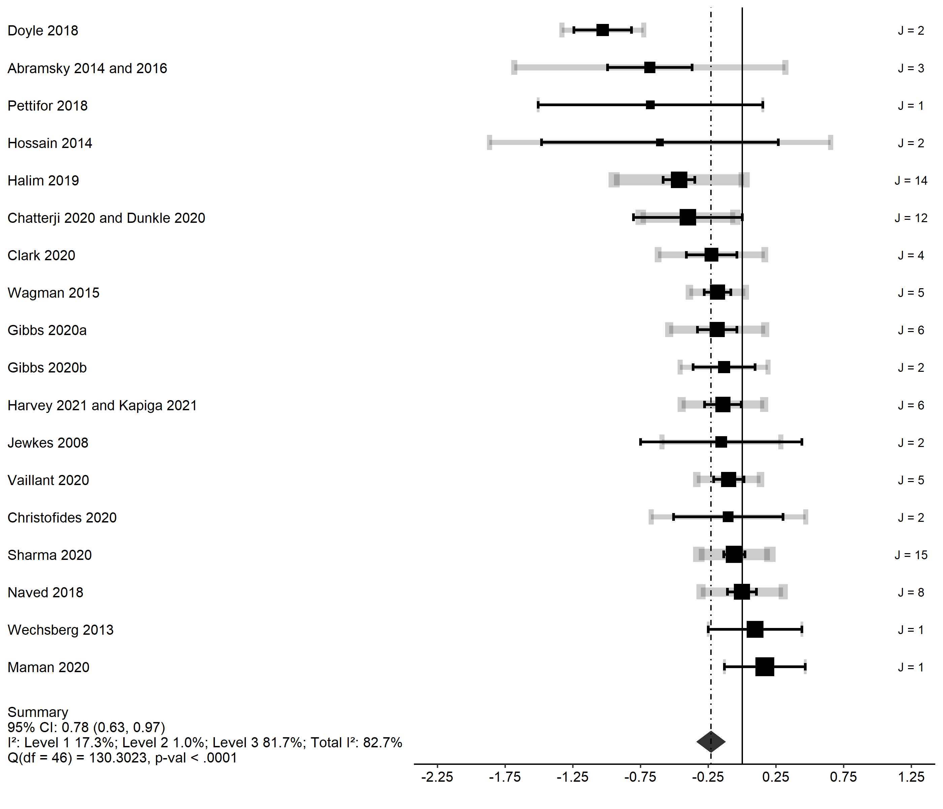
Forest plot

Slide 21
Key findings
Our meta-analysis suggests that community-level or group-based interventions reduce the odds of reported IPV in the past year (pooled aOR 0.78; 95% CI [0.63, 0.96]).
There is wide heterogeneity in the effect sizes between trials (I²=82%).

Slide 22
Meta-regression
(intervention type; target population)
Intervention type (Referent: Joint intervention) | Risk ratio (95% CI)
Women | 0.984 (0.537, 1.802)
Men | 0.826 (0.454, 1.502)
Couples | 0.839 (0.456, 1.542)
Community | 0.623 (0.327, 1.188)
Target population (Referent: No restrictions)
Youth | 0.616 (0.347, 1.094)
Cohabiting | 0.832 (0.467, 1.483)
Intercept | 1.088 (0.656, 1.084)
Test of Moderators (coefficients 2:7): | 0.984 (0.537, 1.802)
F(df1 = 6, df2 = 40) = 2.131, p-val = 0.071 | 0.826 (0.454, 1.502)

Slide 23
Meta-regression
(intervention components; duration)
Intervention components (Referent: no additional components)
HIV/SRH | 1.134 (0.815, 1.580)
Substance use | 0.536 (0.274, 1.050)
Economic empowerment | 1.502 (0.946, 2.387)
Parenting | 0.363 (0.229, 0.574)
Intervention duration (Referent: low intensity, short duration)
High intensity | 1.108 (0.801, 1.533)
Long duration | 0.700 (0.483, 1.017)
Intercept | 0.816 (0.619, 1.076)
Test of Moderators (coefficients 2:7):
F(df1 = 6, df2 = 40) = 4.159, p-val = 0.0024

Slide 24
Key findings
There is no evidence that intervention type was associated with intervention effectiveness.
Interventions targeting youth generated somewhat larger reductions in IPV (OR=0.62, 95% CI: [0.35, 1.09]).
There was also evidence that some intervention components were associated with effectiveness.
Interventions including a component targeting parenting practices showed larger reductions in IPV (OR=0.36, 95% CI: [0.23, 0.57]).
Interventions including a component targeting substance use showed a similar pattern that is noisily estimated (OR=0.54, 95% CI: [0.27, 1.05]).

Slide 25
Summing up
This is promising evidence that gender-transformative interventions can work; but there is clearly huge variation.
Understanding more about what interventions work best, and where, will be a critical part of this research agenda.

Slide 26
Moving beyond gender-transformative interventions
The broad literature on prevention and reduction of IPV is far too wide to encompass in a single lecture – but also important to highlight the important contribution researchers at IFPRI (and collaborating institutions) are making in exploring the role of cash in reducing IPV.
Cash transfers can have many economic benefits (though this is a large literature in and of itself) and also can have substantial effects on reducing IPV, primarily by reducing poverty-related stress.
The cash and IPV collaborative - including researchers from UNC, University of Buffalo, LHSTM, and many others - has a wide interdisciplinary portfolio around the effects of cash: cash-ipv.org

Slide 27
Thank you!

